Slide 1
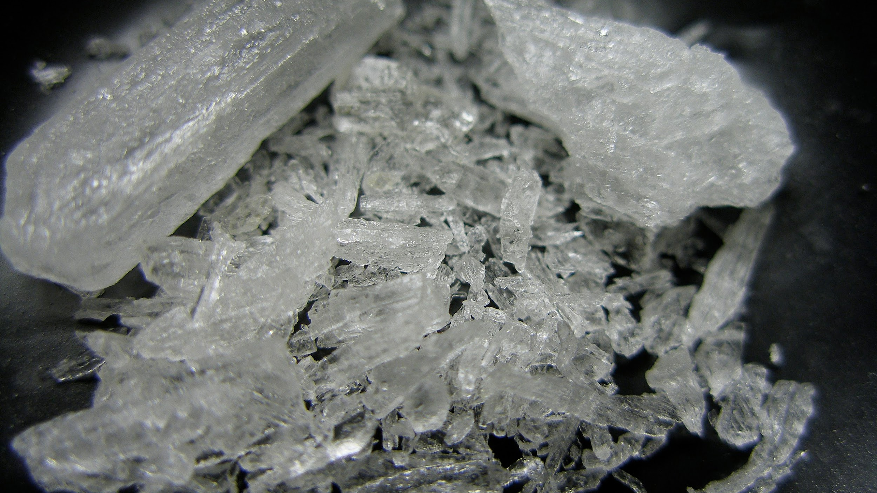
Breaking Bad Analysis
By Joldea Andrei & Lazarov Andrei
“Politehnica” University of Timișoara

Slide 2
What is Breaking Bad?
American crime-drama TV series
Produced by Vince Gilligan
Aired 2008 - 2013
Chemistry teacher and former student producing and selling crystal meth
Notes:
Breaking Bad is an American crime drama television series created and produced by Vince Gilligan. Set and filmed in Albuquerque, New Mexico, the series follows Walter White (Bryan Cranston), an underpaid, overqualified, and dispirited high-school chemistry teacher who is struggling with a recent diagnosis of stage-three lung cancer. Walt turns to a life of crime and partners with a former student, Jesse Pinkman (Aaron Paul), to produce and distribute crystal meth to secure his family's financial future before he dies, while navigating the dangers of the criminal underworld. The show aired on AMC from January 20, 2008, to September 29, 2013, consisting of five seasons for a total of 62 episodes.

Slide 3


Slide 4
Analysis methods
Technical topics:
Data Cleaning & Preprocessing
Web Scraping
TF-IDF
N-Grams
NER
Sentiment Analysis
What steps did we take?

Slide 5

Analysis Steps

Slide 6
Data Cleaning & Preprocessing
Original dataset is from Kaggle and contains 10 columns:
Date
Season
Episode
Title
Duration
Directed by
Written by
Summary
IMDb Rating
U.S. viewers
Notes:
The dataset that we used is https://www.kaggle.com/datasets/varpit94/breaking-bad-tv-show-all-seasons-episodes-data. It contains information about each Breaking Bad episode including: title, season, episode number, writer, director, IMDB Rating, US Viewership etc.

Slide 7
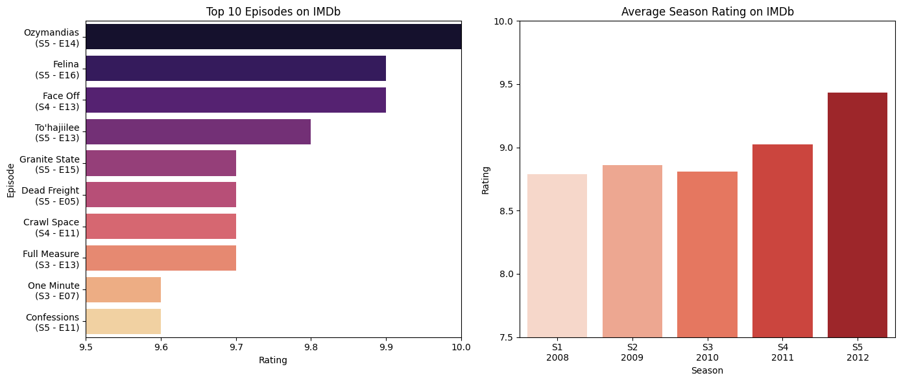
Episode and Season ranking

Slide 8
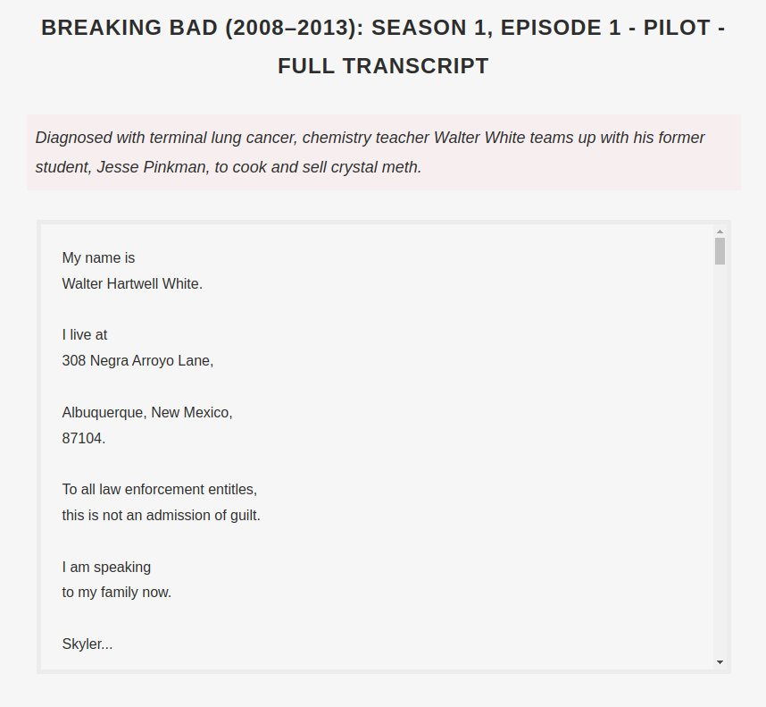
Web Scraping
Full transcript of each episode
Notes:
To the kaggle dataset, we’ve added the full script for each episode, by scraping the website https://subslikescript.com/series/Breaking_Bad-903747.

Slide 9
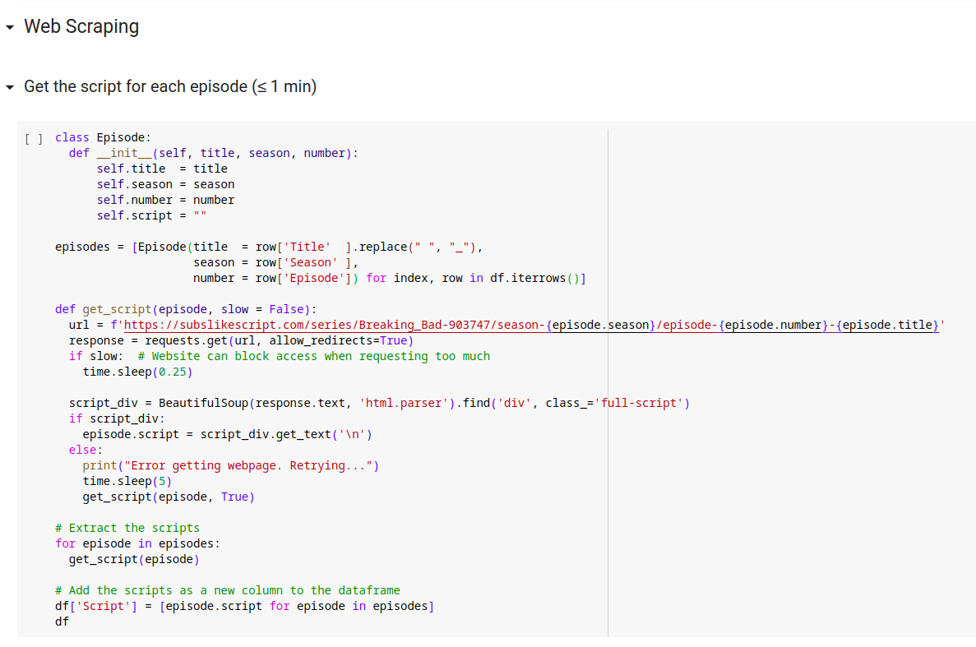

Slide 10
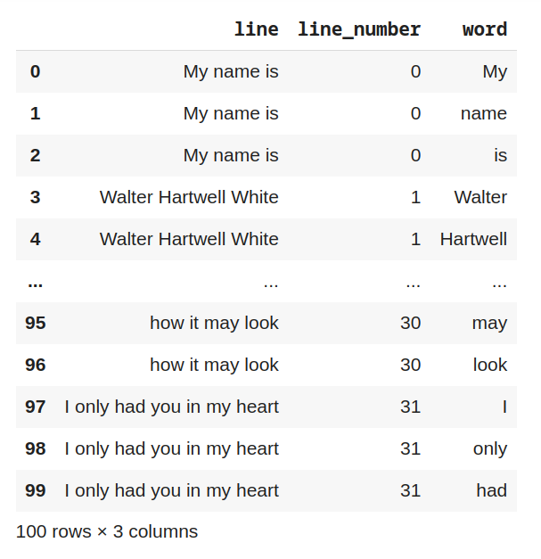
TF-IDF
Most relevant words
Notes:
The next step was to get the top TF-IDF values in the script. Although we didn’t have multiple documents to work with in this scenario, we thought it would be useful to see the most relevant terms in the whole concatenated script.
First, we’ve concatenated the whole script of the show, from the ‘Script’ column and applied some preprocessing to the text.
We’ve created a new dataframe, consisting of each line, line number and word.

Slide 11
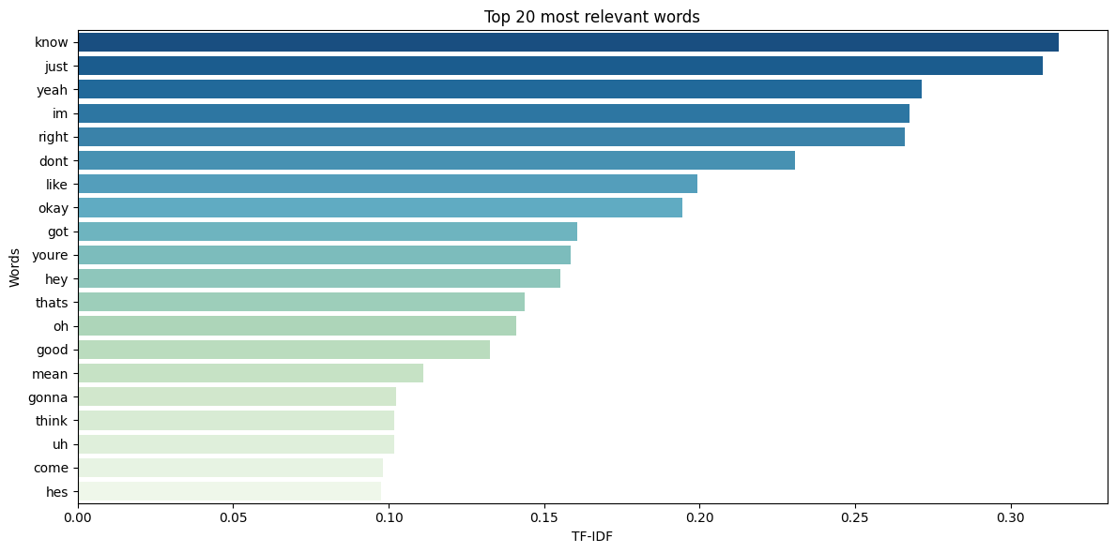
Notes:
After eliminating common English words, we’ve plotted the most relevant 20 words, based on TF-IDF.

Slide 12
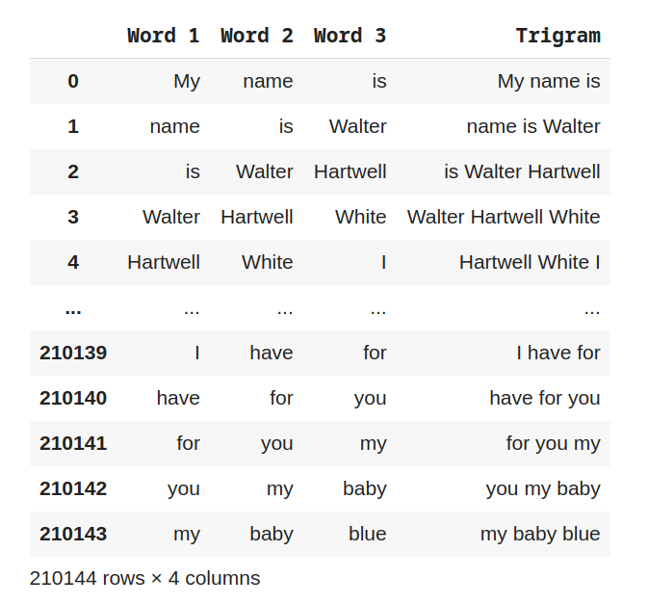
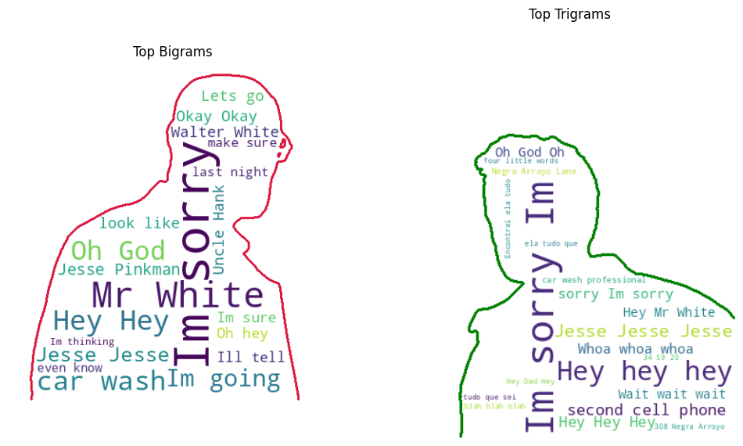
N-grams
Most frequent 2-word and 3-word phrases

Slide 13
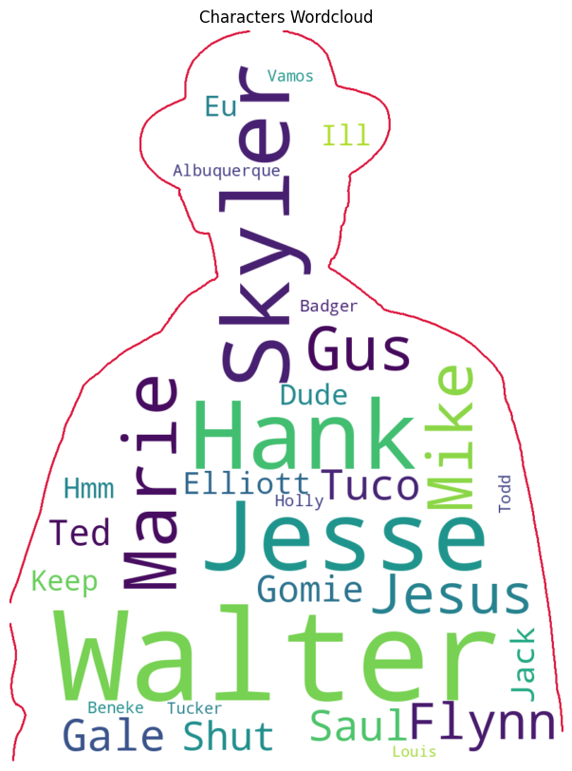
Named-entity recognition
We used NER to extract all the names from the script
Grouped them into characters
Counted occurrences to find who is the most relevant
Also tested the correlation between their frequency and episode rating
Notes:
Now, we wanted to analyze the most relevant character names in the show, by applying the NER algorithm on the combined script of all the episodes.
This is not bad, but we can see some inadequacies in the result.
Names such as ‘Walt’, ‘Walter White’, ‘Walter’ or ‘Jesse’ and ‘Jesse Pinkman’ all refer to the same person, so we want to group these together and have a common counter for them.
To achieve this, we make a few improvements to the code, by mapping name variations to a single name.
Now our output reflects the most relevant characters in the show more accurately.
We also create a wordcloud with the top 20 character names.

Slide 14
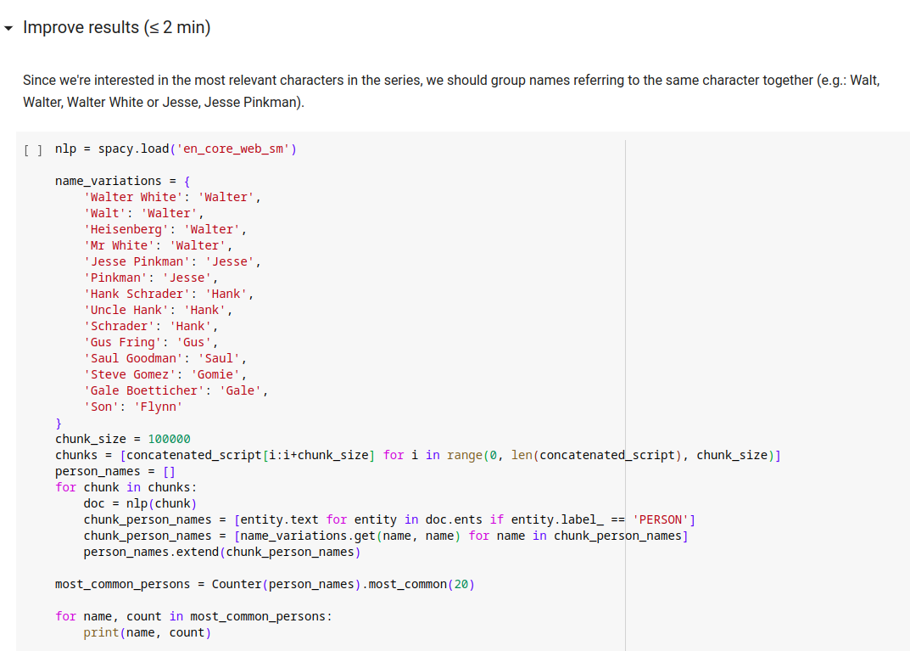

Slide 15
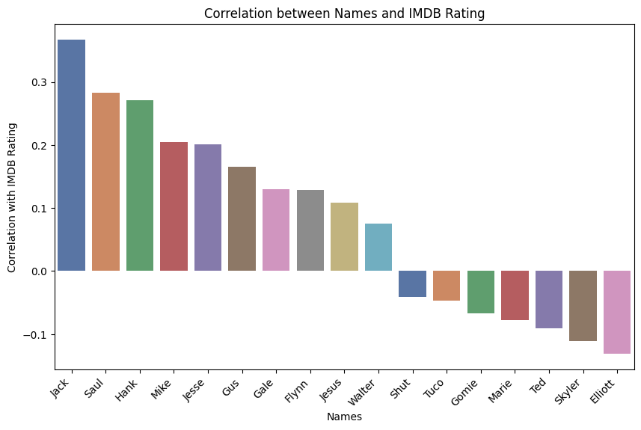
Notes:
To see how the frequency of each character name in the script of the episode affects the IMDB Rating of that episode, we create a new dataframe, using the previous dataframe together with the most common character names.

Slide 16
Sentiment Analysis
How does sentiment affect the rating and views?
Compute score for each episode

Slide 17
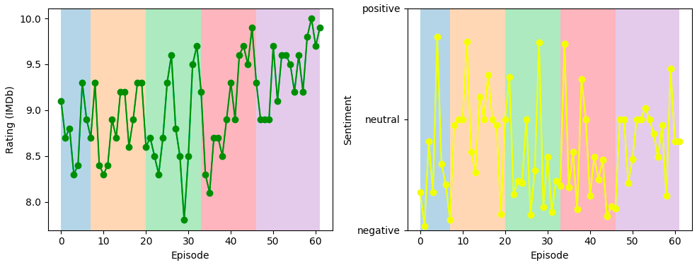
Episode characteristics

Slide 18
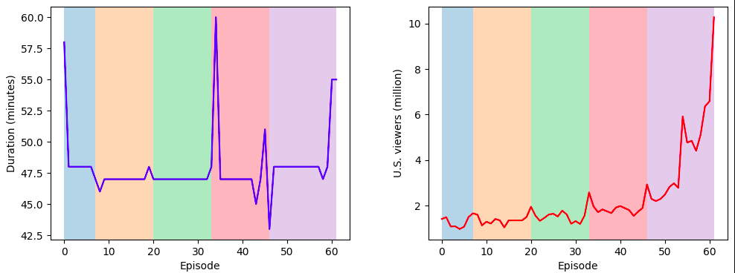
Episode characteristics

Slide 19
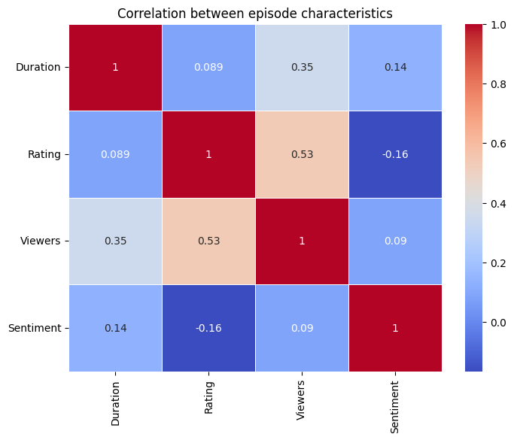

Slide 20
Python Notebook on Google Colab
Presentation on Google Slides

